Slide 1


Customer Shopping Behavior Analysis
Uncovering insights from transactional data to drive strategic business decisions.

Slide 2
Project Overview
This project analyzes 3,900 customer purchases to understand spending patterns, segments, product preferences, and subscription behavior.
Goal
Data Source
Guide strategic business decisions through data-driven insights.
Transactional data from 3,900 purchases across various product categories.

Slide 3
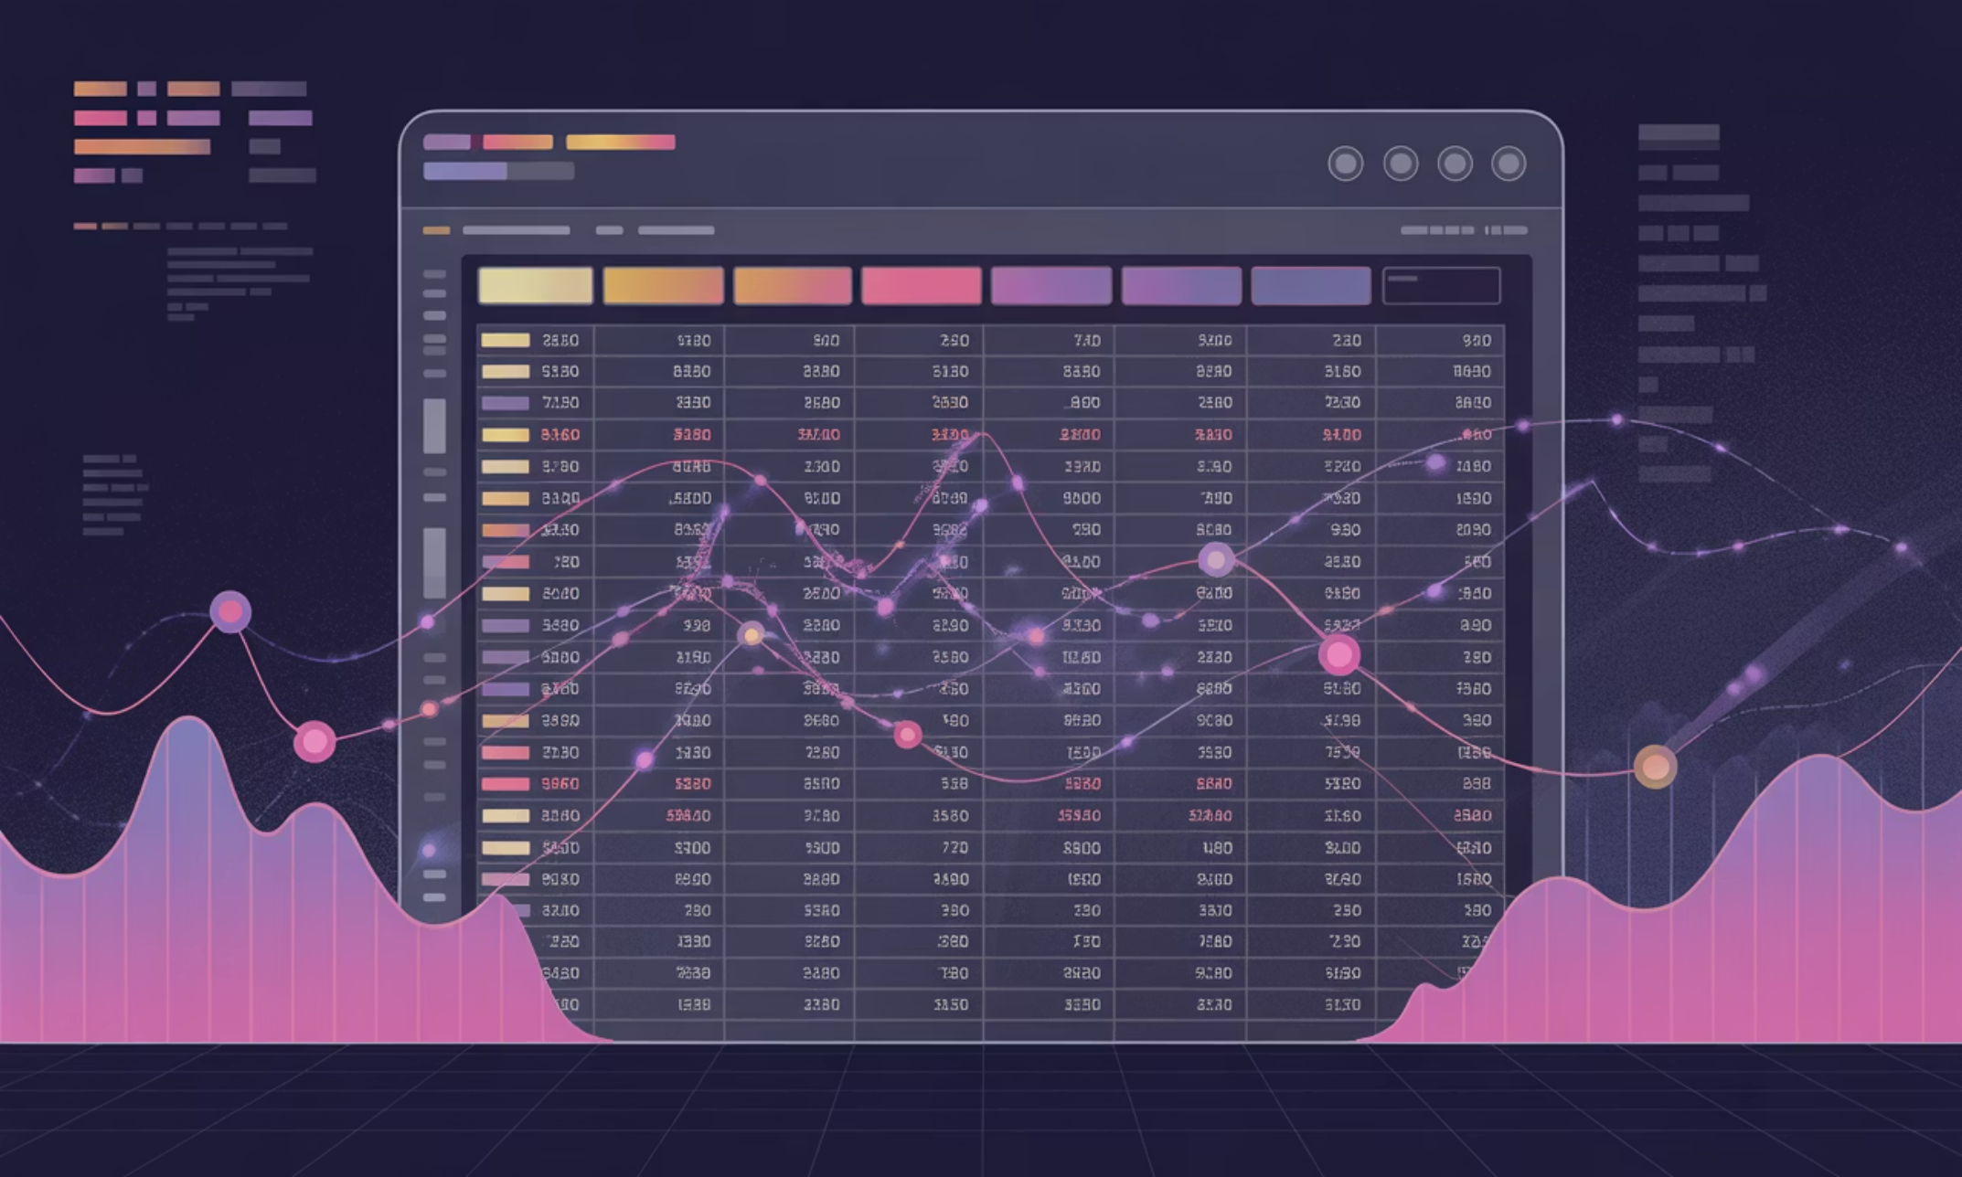
Dataset Summary
Our dataset comprises 3,900 rows and 18 columns, capturing a comprehensive view of customer interactions.
Customer Demographics: Age, Gender, Location, Subscription Status
Purchase Details: Item, Category, Amount, Season, Size, Color
Shopping Behavior: Discount, Promo, Previous Purchases, Frequency, Review Rating, Shipping Type

Slide 4
Exploratory Data Analysis (Python)
Our Python-based EDA involved crucial steps to prepare and refine the dataset for analysis.
01
02
03
Data Loading & Exploration
Missing Data Handling
Column Standardization
Imported data with pandas, checked structure with df.info() and .describe().
Imputed 37 missing 'Review Rating' values using the median rating per product category.
Renamed columns to snake_case for improved readability.
04
05
Feature Engineering
Data Consistency & Integration
Created 'age_group' and 'purchase_frequency_days' columns.
Dropped redundant 'promo_code_used' and loaded cleaned data into PostgreSQL.

Slide 5

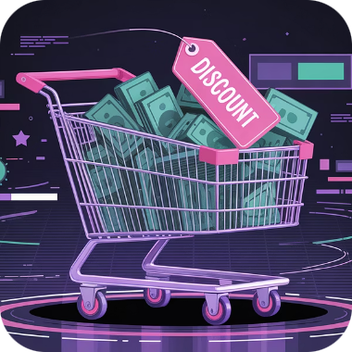

Data Analysis (SQL): Key Business Insights
Structured SQL queries revealed critical customer and product trends.
Revenue by Gender
High-Spending Discount Users
Top 5 Products by Rating
Male customers generated $157,890, females $75,191.
Identified 839 customers who used discounts but spent above average.
Gloves (3.86), Sandals (3.84), Boots (3.82), Hat (3.80), Skirt (3.78).

Slide 6
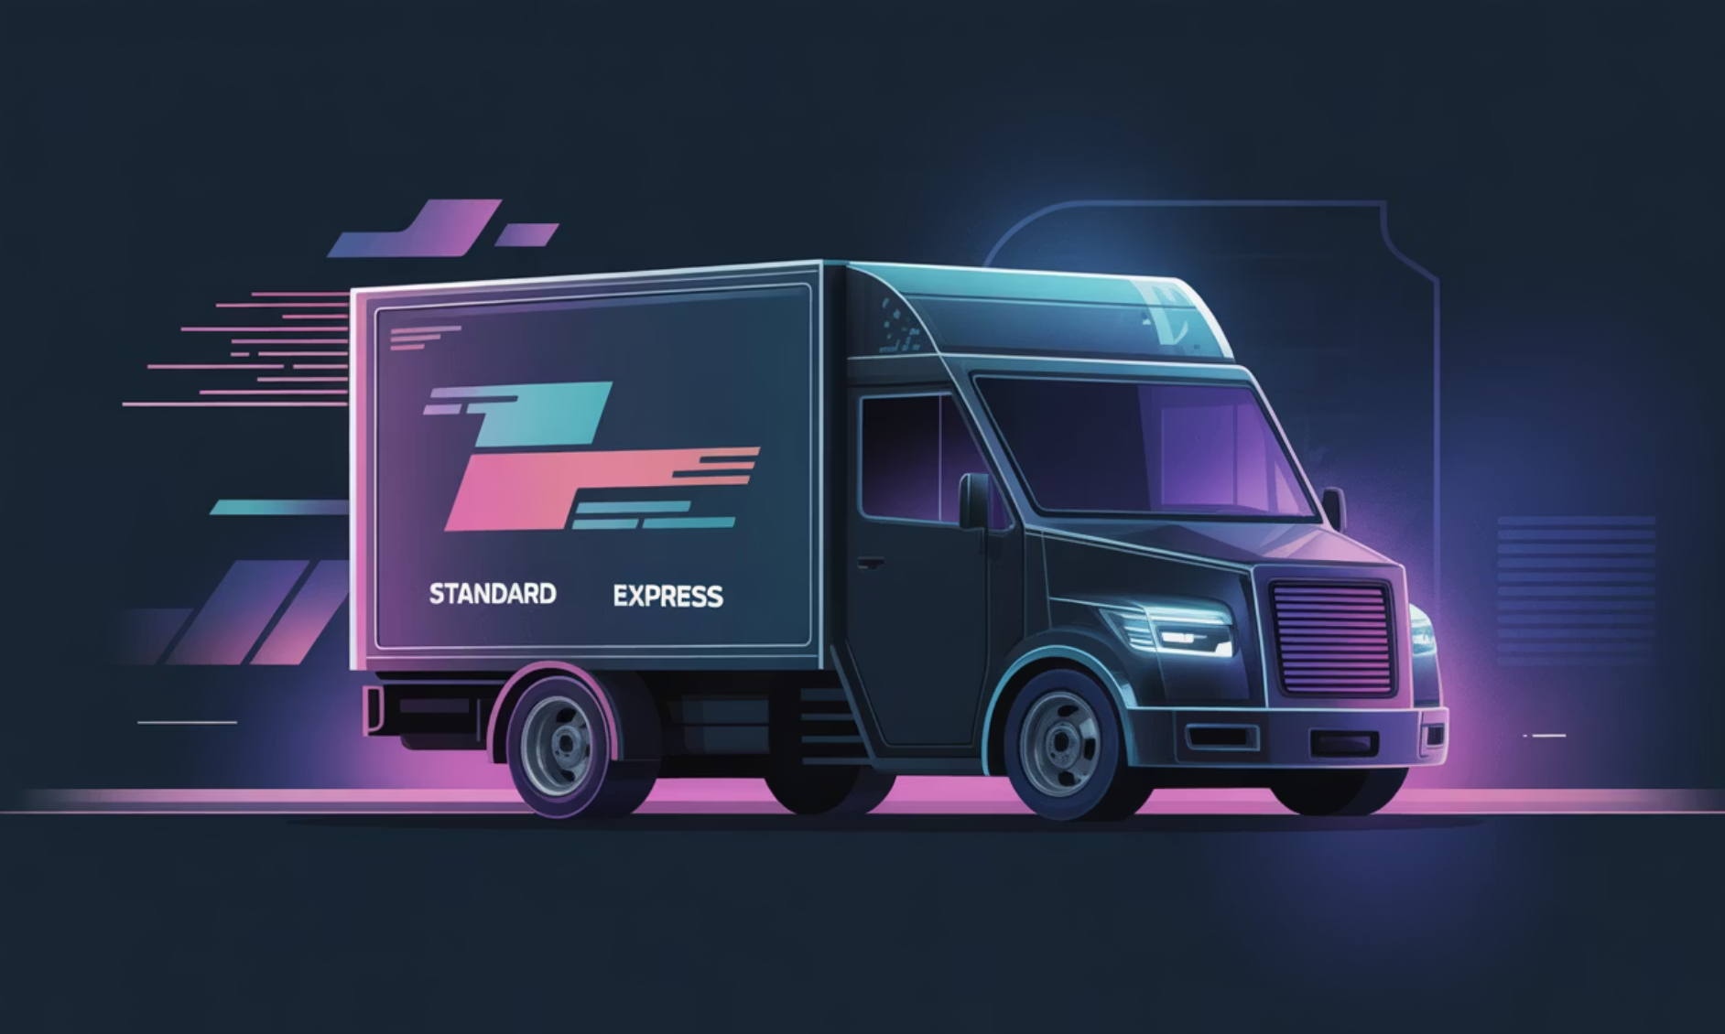

Shipping & Subscription Insights
Subscribers vs. Non-Subscribers
Shipping Type Comparison
Subscribers (1053 customers) averaged $59.49 spend, non-subscribers (2847 customers) averaged $59.87.
Average purchase amounts: Standard ($58.46) vs. Express ($60.48).

Slide 7



Product & Customer Segmentation
Discount-Dependent Products
Customer Segmentation
Top Products per Category
Loyal (3116), Returning (701), and New (83) segments identified based on purchase history.
Jewelry (Accessories), Blouse (Clothing), Sandals (Footwear), Jacket (Outerwear) were top sellers.
Hat (50%), Sneakers (49.66%), Coat (49.07%), Sweater (48.17%), Pants (47.37%) had highest discount rates.

Slide 8
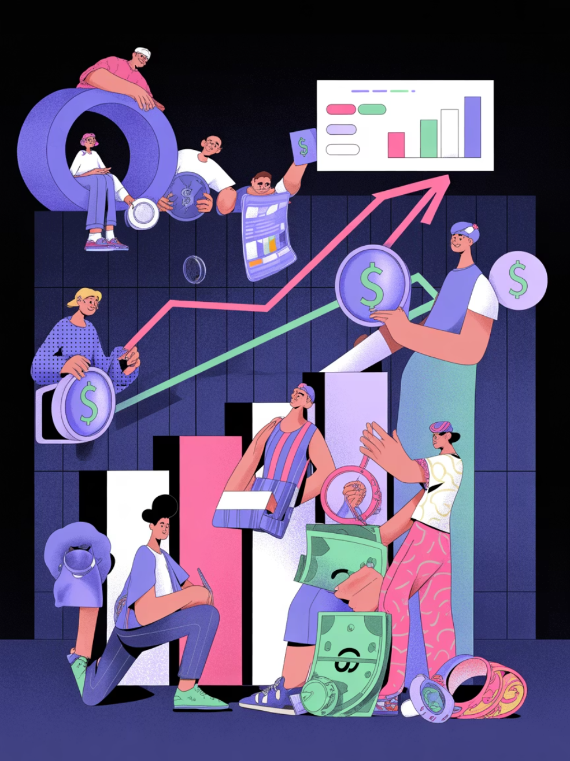
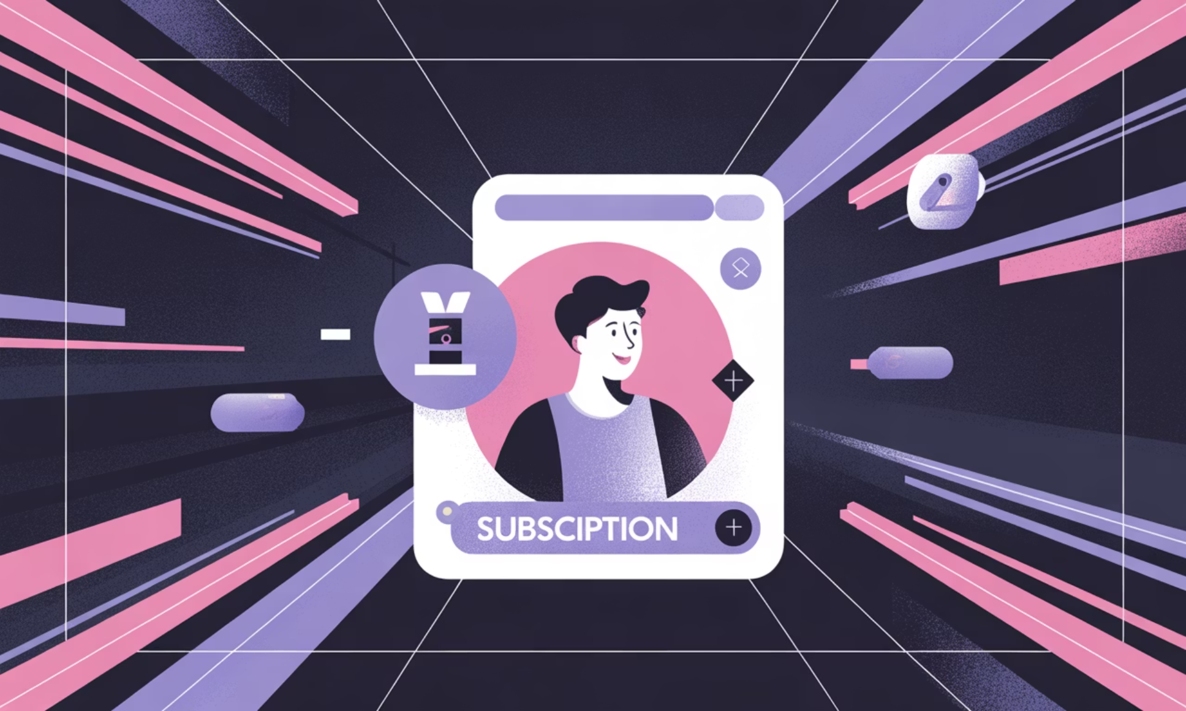
Repeat Buyers & Revenue by Age
Revenue by Age Group
Repeat Buyers & Subscriptions
Young Adults ($62,143) and Middle-aged ($59,197) groups contributed the most revenue.
Customers with >5 purchases: 958 subscribed, 2518 did not. Repeat buyers are more likely to subscribe.

Slide 9
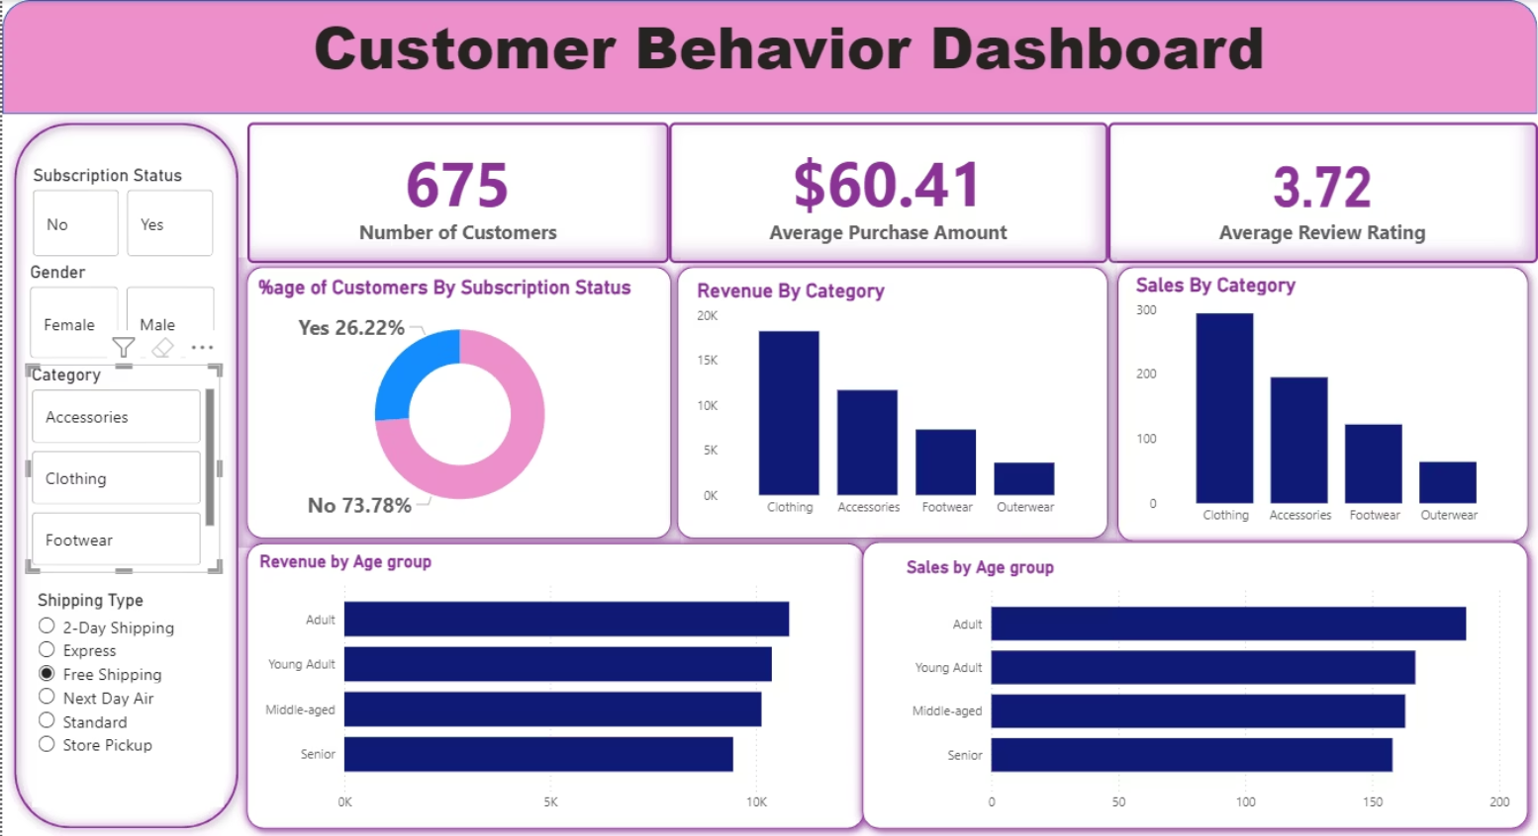
Power BI Dashboard: Visualizing Insights
An interactive Power BI dashboard provides a visual summary of customer behavior, including:
Number of Customers: 3.9K
Average Purchase Amount: $59.76
Average Review Rating: 3.75
Subscription Status: 27% Yes, 73% No
Revenue by Category: Clothing ($100K), Accessories ($70K)
Revenue by Age Group: Young Adult ($45K), Middle-aged ($40K)

Slide 10

Business Recommendations
Leveraging these insights, we propose actionable strategies for growth and efficiency.
Boost Subscriptions
Promote exclusive benefits to increase subscriber base.
Customer Loyalty Programs
Reward repeat buyers to foster loyalty and move them into the “Loyal” segment.
Review Discount Policy
Optimize discount strategies to balance sales boosts with margin control.
Product Positioning
Highlight top-rated and best-selling products in marketing campaigns.
Targeted Marketing
Focus efforts on high-revenue age groups and express-shipping users for maximum impact.

